Slide 1
Stock Analysis
Project 1
Samuel Henderson
Notes:
Good morning
name
Welcome stock analysis
Lets get in to it

Slide 2

ETL Pipeline
Notes:
First High level overview of ETL pipeline
Then we’ll take look at the code

Slide 3
Extract
SONY, MSFT, NVDA, F, TSLA, VT
Polygon REST API
Store with Pandas
Notes:
First extraction
SONY MSFT NVDA F TSLA, VT(ETF)
Use polygon rest api retrieve stock info
Store in dataframe with pandas

Slide 4
Transform
Check
Check data, columns, values, and data types
Remove
Remove unused columns
Convert
Convert data types
Notes:
Next tranformation
First step,
- check received data
- Check what columns
- Missing values
- Data types
Remove unused data wont need
Convert data types that need to

Slide 5
Load
Convert to CSV
Load into SSMS
Notes:
Finally loading
Convert clean dataframes csv for later visualization - tableau
Use SQL Alchemy load to ssms

Slide 6
Let's look at the code

Slide 7
Metrics & KPIs
Notes:
Metrics and Key Performance Indicators
With help of csv, created candlestick charts for each – tableau
Bar graph showing stock performance

Slide 8
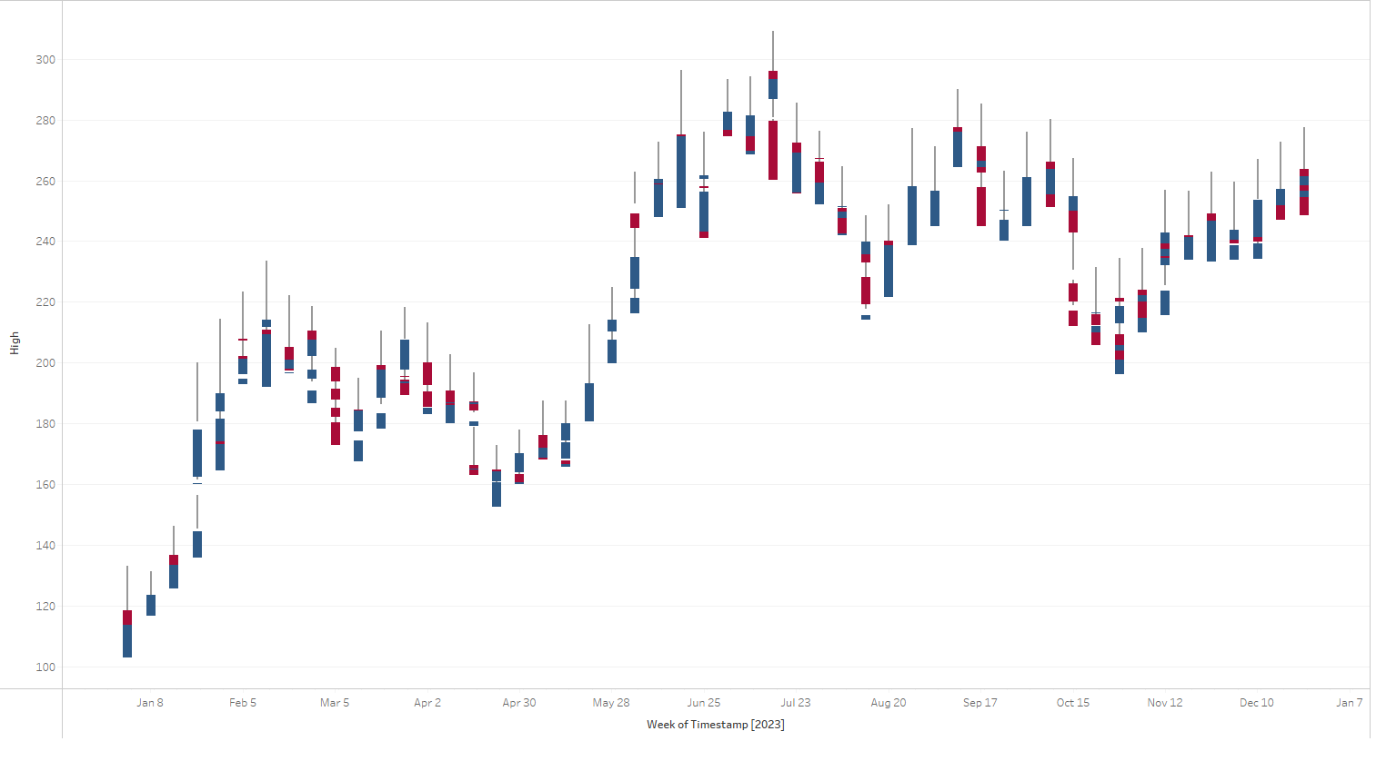
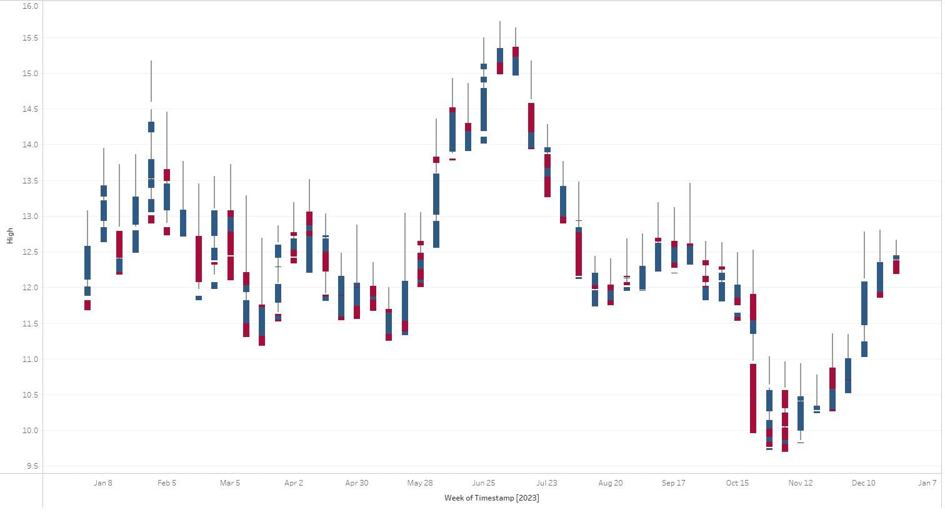
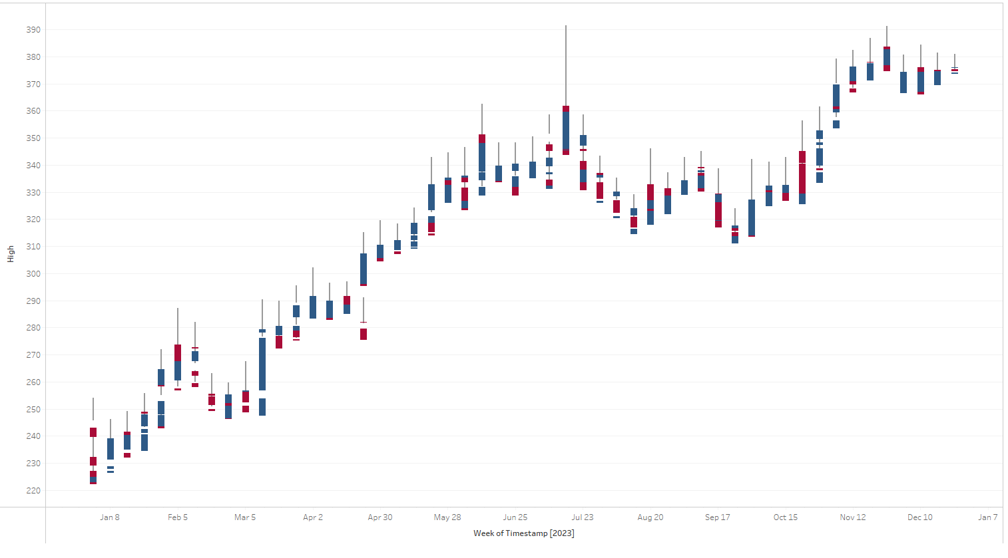
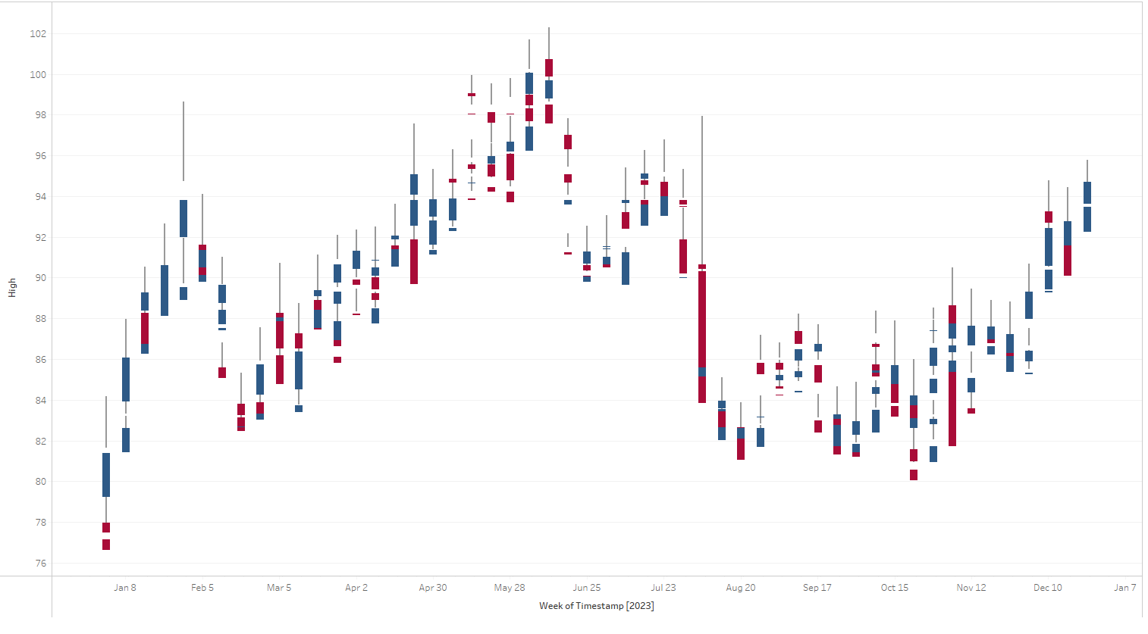
TSLA
F
MSFT
SONY
Notes:
Charts show trends over the year
Help determine price movement analyzing past patterns

Slide 9
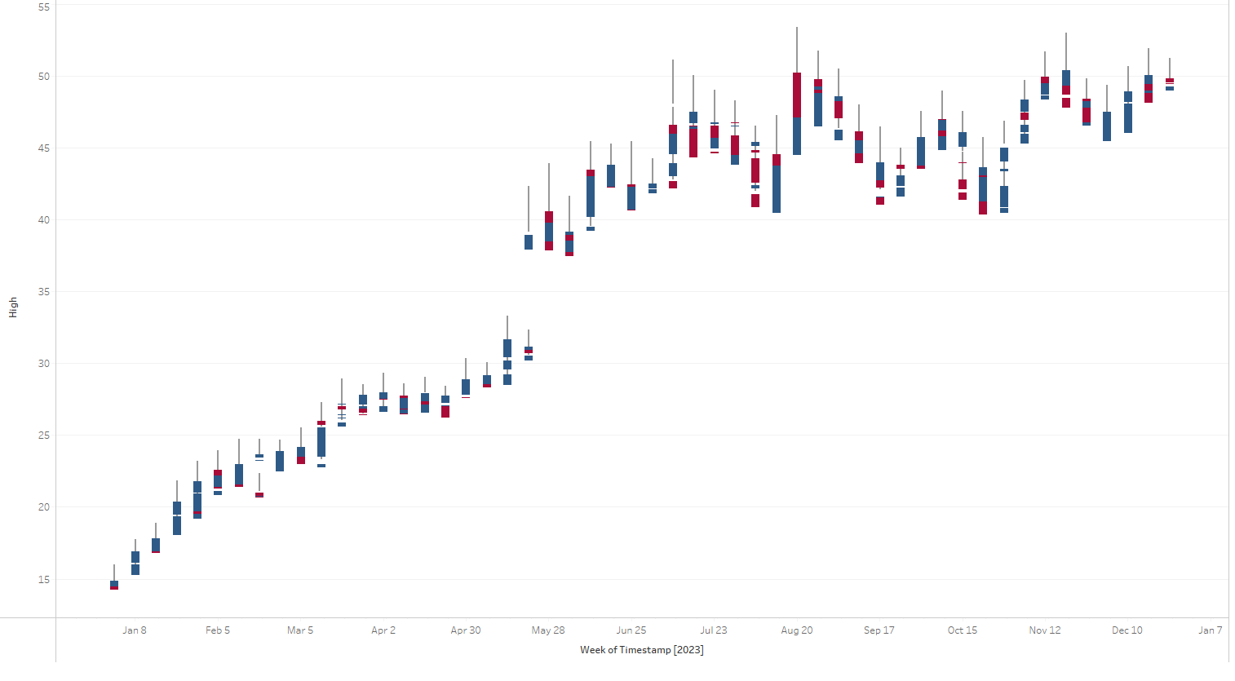
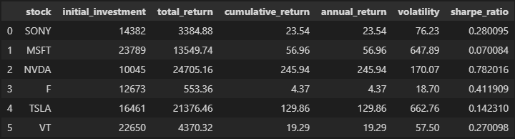
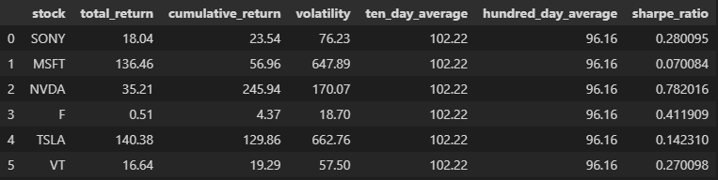
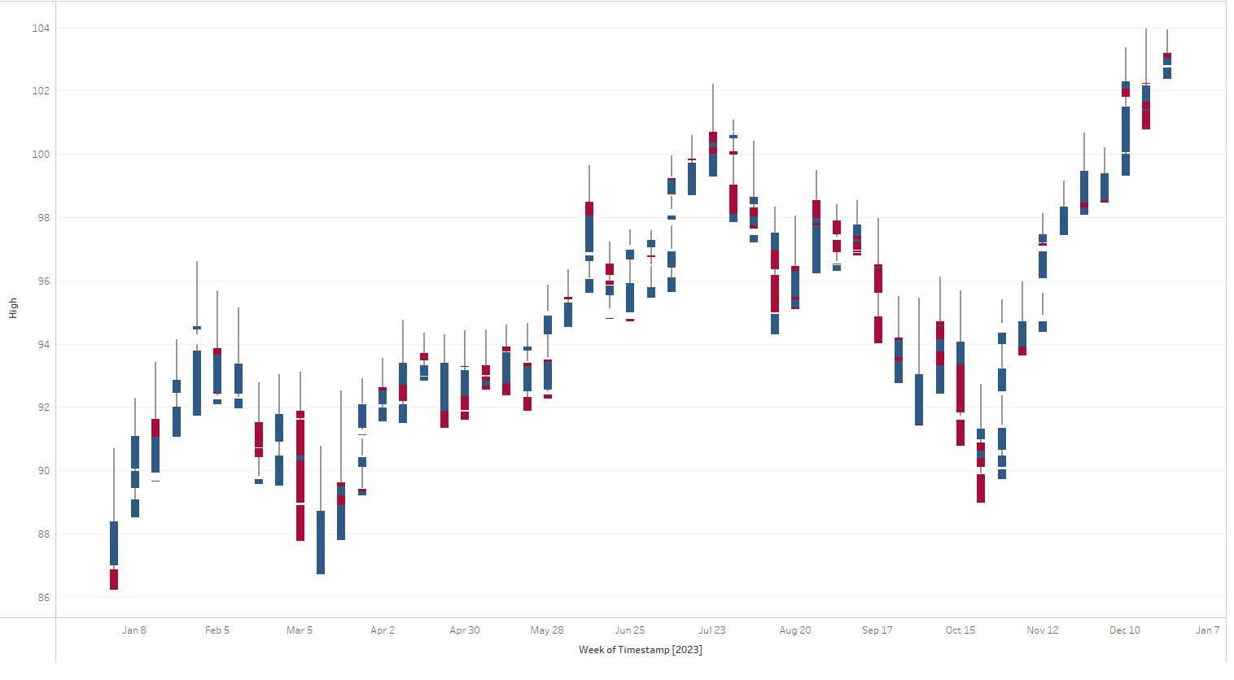
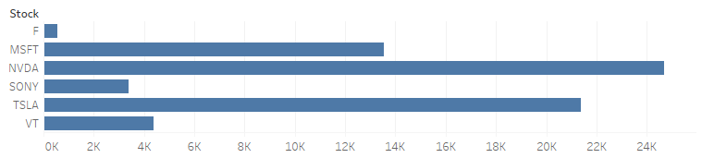
NVDA
Portfolio Metrics
Stock Metrics
VT
Total Returns
Notes:
Also NVDA and VT
Metrics
Bar graph showing how well stock did
3 well last year, 3 not as well but yielded profit

Slide 10
Questions?
Notes:
Thank you for listening
If questions please let me know

